Slide 1


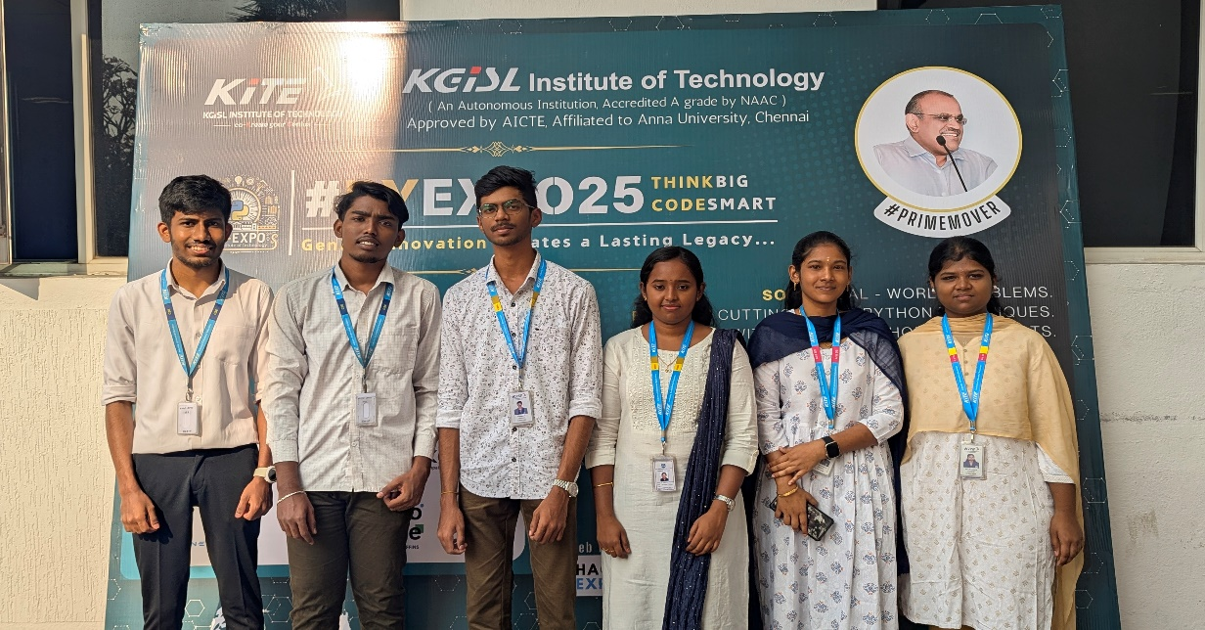
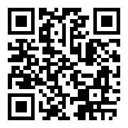

PYEXPO’25
Team Group Photo
Team name : Data Mavericks
Team ID : T053
Problem statement :
Smart Energy Meter for Household Consumption:
Traditional energy meters provide little insight beyond total consumption, making it hard for users to optimize their electricity usage. They face challenges like , lack of real-time monitoring and breakdown of appliance-level consumption, high electricity bills due to inefficient usage and environmental impact from excessive energy consumption.
Proposed solution :
The Smart Energy Meter is designed to monitor household electricity consumption in real-time, helping users optimize usage, cut costs, and reduce environmental impact.
Objective: provide real-time energy tracking, offer appliance-level insights to identify high-consumption devices and send alerts & energy-saving suggestions to reduce wastage.
Proposed Solution: Sensors (SCT-013, ZMPT101B) measure current & voltage, ESP32 (Wi-Fi) transmits data to the cloud, Mobile App/Web Dashboard displays real-time usage & alerts and AI-driven insights help optimize energy consumption.
Outcome: Lower electricity bills, reduced energy waste, and a smarter, eco-friendly home.
Project outcome :
Lower electricity bills by efficient usage of current, reduces the environmental impact by decreasing excessive energy consumption and to build a smarter , eco-friendly home.
https://github.com/PYEXPO25/T053_DATAMAVERICKS
POWERED BY
pyexpo.co
IPS TECH COMMUNITY
FOR MORE VISIT :

